Slide 1
This is a hidden slide
Dear honorable teacher please follow the instructions that has given in the slide notes (under the every slide). It would be helpful to take a successful class. Thanks a lot. I wish you good luck.

Slide 2

WELCOME

Slide 3
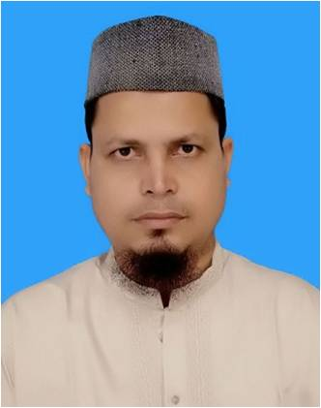

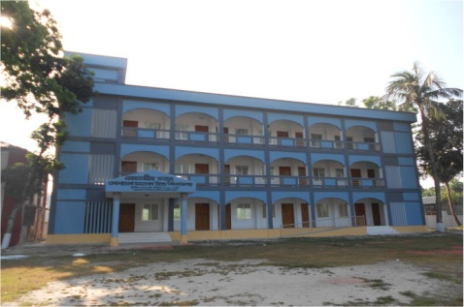
IDENTITY
SK. Md. Harunar Rashid
Senior Assist: Teacher
Sonatola Model High School, Sonatola, Bogra.
ENGLISH FOR TODAY
CLASS : SIX
UNIT ----
LESSON – 25

Slide 4
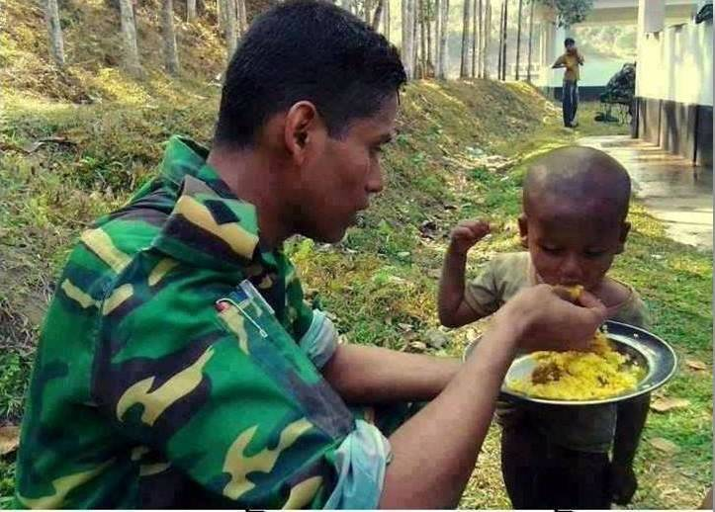
Pre-Knowledge test:
Who is he and what is he doing ?
He is a Bangladeshi army and feeding an African baby who lives in Congo.
Notes:
Teacher will try to elicit the answer from the SS then he/she will give feedback by animation.

Slide 5
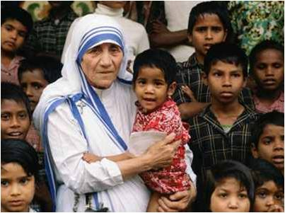
Pre-knowledge test
She is Mother Teresa and folding a baby in the arms from an orphan.
Who is she and what is she doing ?
Notes:
Teacher will try to elicit the answer from the SS then he/she will give feedback by animation.

Slide 6
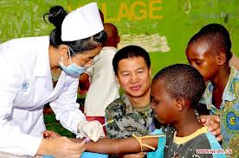
Pre-knowledge test
She is an Indian nurse and nursing an African baby who lives in Congo.
Who is she and what is she doing ?
Notes:
Teacher will try to elicit the answer from the SS then he/she will give feedback by animation.

Slide 7
T: My dear students can you imagine why they are doing so ? Though they are not citizen of the same country.
S: Sir, I mean, at present we live in a global village, so they are doing that.
Notes:
Teacher will try to elicit the answer from the SS then he/she will give feedback by animation.

Slide 8
Lesson Declaration
So Today we shall discuss about
WE LIVE IN A GLOBAL VILLAGE.

Slide 9
Learning outcomes
After completing this lesson students will be able to -
read and understand texts
follow instructions, commands, requests and act accordingly
ask and answer questions
understand and enjoy stories and poems

Slide 10
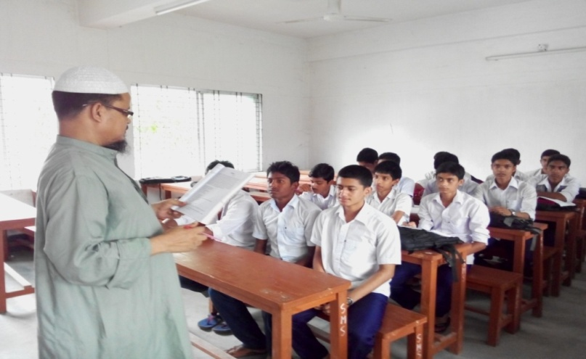
Model Reading
Close your book, listen me attentively then ask and answer the following questions with your partner.
Where is Cango ?
What is Sohan’s uncle ?
What does Sohan’s uncle do in Congo ?
Who call Gurmit Singh ‘Mr Global Citizen’ ? Why ?
What do you mean by ‘global citizen ?
Notes:
Teacher will monitor the class and can make easy to answer the questions.

Slide 11

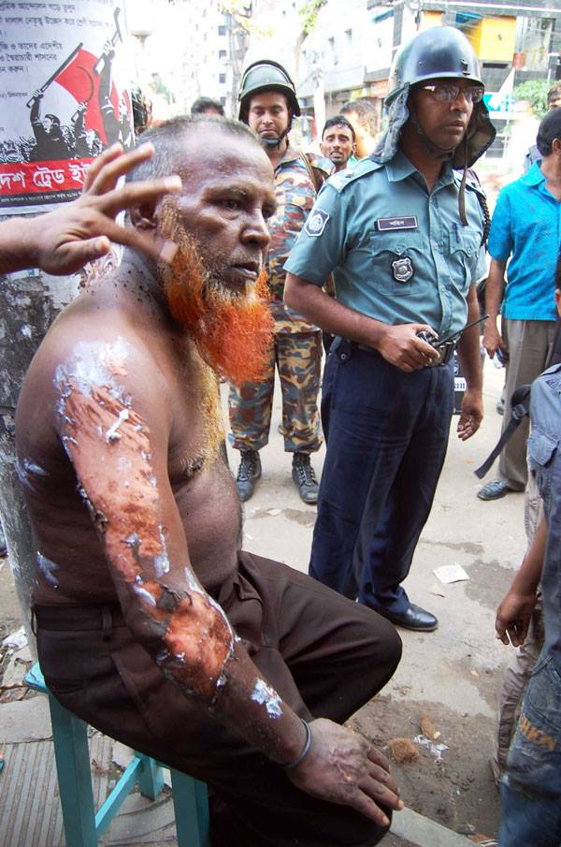
Violence
Key word
Don’t participate any violence act.
Meaning
(Click here)
A cruelty act.
Notes:
First, the word can be shown. The SS can be asked to pronounce the word. If it is needed teacher can help. Then the picture can be shown and asked to guess the meaning. For feedback click on meaning button.

Slide 12
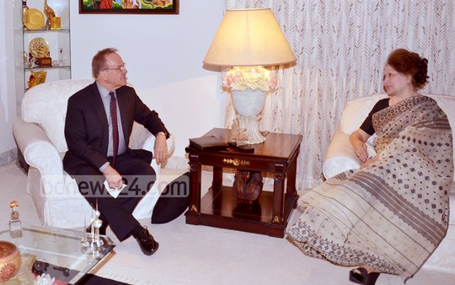
Conversation
Key word
Fruitful conversation is very important for development.
Meaning
(Click here)
Make a dialogue
Notes:
First, the word can be shown. The SS can be asked to pronounce the word. If it is needed teacher can help. Then the picture can be shown and asked to guess the meaning. For feedback click on meaning button.

Slide 13
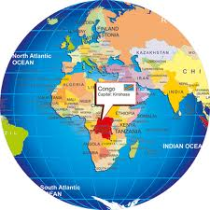
Global
Key word
Now we live in a global village.
Meaning
(Click here)
International
Notes:
First, the word can be shown. The SS can be asked to pronounce the word. If it is needed teacher can help. Then the picture can be shown and asked to guess the meaning. For feedback click on meaning button.

Slide 14
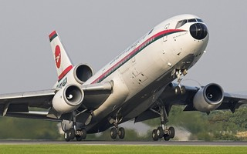
Leave for
Key word
President left for Singapur for treatment.
Meaning
(Click here)
Go away
Notes:
First, the word can be shown. The SS can be asked to pronounce the word. If it is needed teacher can help. Then the picture can be shown and asked to guess the meaning. For feedback click on meaning button.

Slide 15
VOCABULARY
Main word | Synonym | Antonym
Ago (adv) | before | after
Violence (n) | turbulence | friendly
Complete (adj) | fulfill | Incomplete
Global (adj) | International | national
Smile (v) | Laugh | Cry
Notes:
Teacher can discuss all the new word`s synonym and antonym. Firstly he/she can try to elicit the answer from the SS then he will give feedback.

Slide 16
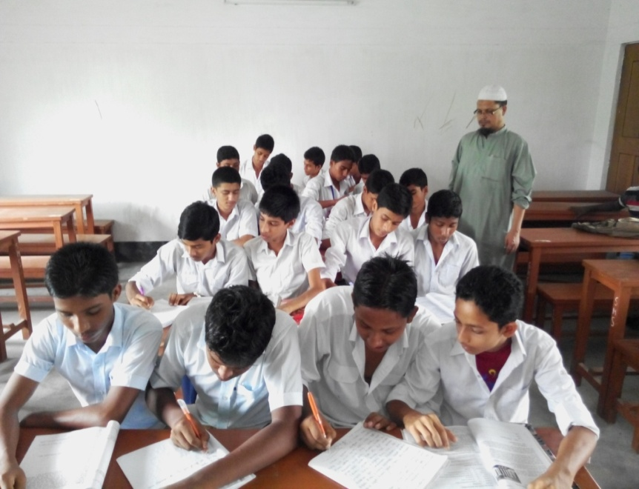
Individual / Pair works
Read the letter carefully and go to section B1. Now match the words in column A with their meaning in column B.
Notes:
SS will do according to direction teacher will monitor the class and can make easy to solve the problem.

Slide 17
Individual / Pair works
Click here
Listen the Audio, then go to section ‘C’ and fill in the following gaps.
Notes:
Teacher can play the audio more than once or he/she can say loudly the text.

Slide 18

HOME WORK
Make a dialogue between you and your partner about a ‘Global Citizen’.

Slide 19
THE END

